Slide 1
Dean Park Primary School
Parent Council
AGM
29th September 2025

Slide 2
What is the Parent Council?
A Parent Council is a statutory body that represents the views of the parents, primarily, to the school. It is independent of the school and the local authority, it is organised and run by the parents and carers of the school.

Slide 3
What does a Parent Council do?
Represent all the parent and carers at the school
Represent the views of parents/carers wherever necessary
Support the work of the school by contributing on school policies, plans, developments, improvements
Ensure the parent perspective is taken into account
Work in partnership with the school
Provide a voice for parents/carers
Support school/home partnerships
Communicate regularly with parents
Support improvements through discussion
Help to establish and grow links in the wider community
Capture unique and varied skills, interests, knowledge and experience of parents
Support the recruitment of senior staff

Slide 4
Who is on the Parent Council?
Parent/carer members including office bearers
Advisor to PC [Head teacher] and teacher attendees
Local Councillors and community representatives

Slide 5
Our Parent Council 2024/2025 session
Since 2023, the parent council has had limited membership, and we have found it difficult to recruit more members. We are grateful that the following have been involved for all or part of the 2024/2025 year
Chair/Vice Chair – Rose MacCarthy and David Wilson
Treasurer – Julia Paterson
Secretary – Emma Allan-Brown
Parent Members – Douglas Graham, Sonja Fedrizzi, Bruce Wilson, Louise Sinclair
We are in a period of transition, but things are looking positive moving forwards

Slide 6
Proposed Parent Council committee, 2025-2026
Chair: Julia Paterson
Vice-Chair: Emma Allan-Brown
Treasurer: Louise Sinclair
Parent Members: Sonya Fedrizzi, Douglas Graham, Bruce Wilson
We will also shortly be releasing a video to highlight the parent council and our main aims, with the hope of attracting more parents/carers to join us

Slide 7
2024-2025 Projects
Pupil leadership interviews
Safer routes to school – project started and will continue in the 2025-2026 school year
Engineering workshops – provided to all cases P1-P7 by Papilio Engineering (formerly Young Engineers)
Support for vulnerable families

Slide 8
Meetings
All 2024/2025 meetings were held in person at Dean Park Primary School
Meetings are Mon/Tue/Wed night, a combination of in person and online (Teams)
Some meetings are held on the same night as PTA, and the Headteacher’s summary is given to both groups before we split into separate groups

Slide 9
Communication and Social Media
ParentMail communications
Social Media – Facebook
Email
In person
WhatsApp groups
Meeting Minutes – on website

Slide 10
2025-2026 Projects
Safer routes to school – continuation of project started in 2024-2025 school year
Pupil leadership interviews – the format may change, but the PC will continue to provide support as required
Support for vulnerable families

Slide 11
Accounts September 2024-2025
Accounts prepared by our treasurer Julia Paterson
Verified independently
Copies available upon request
Slides will be added to school website

Slide 12
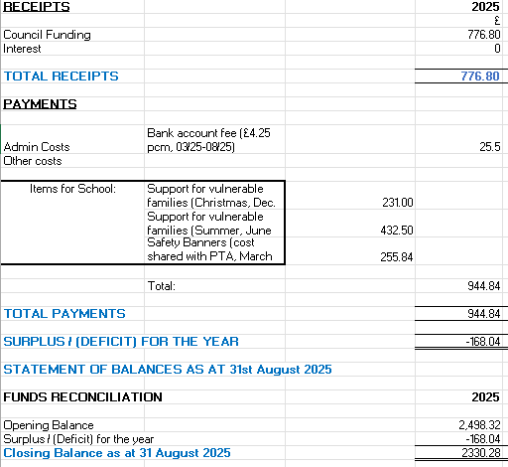

Slide 13
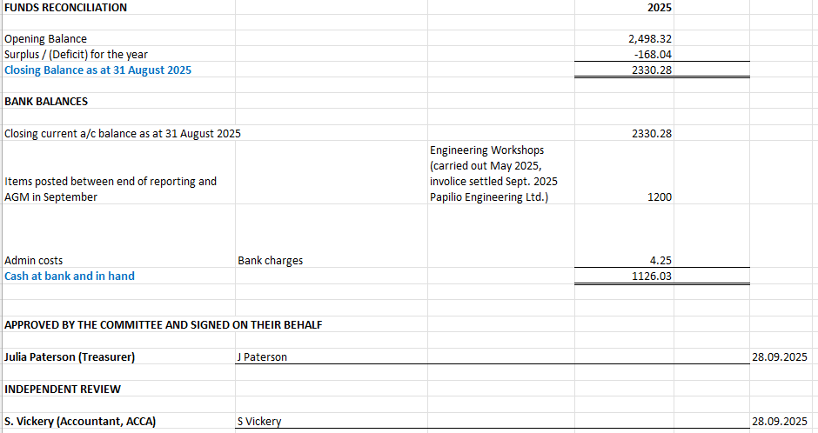

Slide 14
Keep in touch
deanparkparentcouncil@outlook.com
In person
Drop a letter in to the school office addressed to us
Facebook – Dean Park Primary School Parent Forum
Minutes – on website
Dates for meetings:
Wed. 19th November 2025 (online)
Mon. 19th January 2026 (online)
Mon. 27th April 2026 (online)
Tue. 9th June (in person and joint with the PTA)

